Slide 1
Interactions in the Virtual Realm
Jack Cieslik, Chris Marrs, Joseph Han, David Kaye

Slide 2
Project Objectives
PROBLEM : A lack of physical interaction in Virtual Reality can lead to a less engaging experience
SOLUTION : Enable VR users to visualize and interact with physical objects while in VR
Our goal is to create a system that can...
Track and display arc of a moving ball
Capture live motion and display avatar of a user
Enable user to catch a thrown ball while in VR
Notes:
JOSEPH

Slide 3
Design Overview
Ball is tracked with using radar and MATLAB code to calculate projected trajectory
User’s joint positions tracked using an Azure Kinect camera and C++ code with the Kinect API
Subsystems integrated in Vizard with Python where external data is displayed in VR
Notes:
JACK

Slide 4
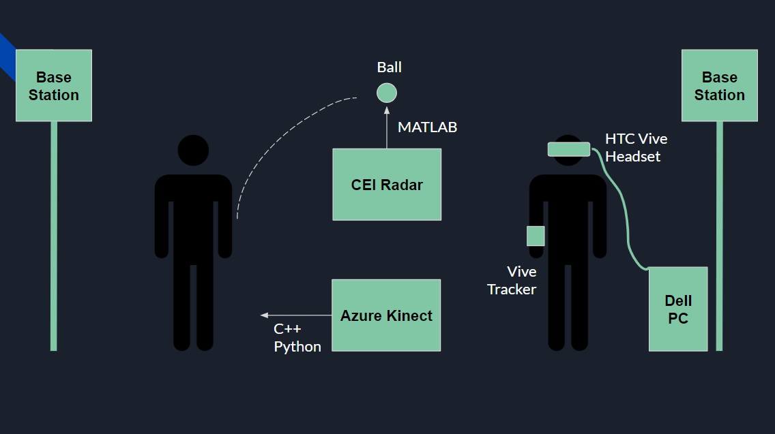
CHRIS
Vive
Tracker
JACK
JOSEPH
Vive
Tracker
DAVID
Notes:
JACK

Slide 5
Radar Subsystem
Colorado Engineering’s iScan Phantom radar module
Radar supported by MATLAB...
Measures initial positional data (xy) of a thrown ball
Calculates the ball’s coefficients for its projected arc using polyfit
Coefficients are written to a text file to be used with equations of motion
Notes:
CHRIS
Using Iscan phantom radar 77GHz
2D coordinates
Measures data in distance and angle from straight above the radar system
Matlab Converts this data into X and Y coordinates
Our program Collects 6 XY data points as the ball is being thrown over the radar system.
Matlabs polyfit function fits a porabola over these data points and the resulting coefficents are written to a text file.
As well each data point has a time stamp, and using this data we calculate the average x and y velocities of the ball which is also written to the same text file.

Slide 6
Motion Tracking Subsystem
Azure Kinect Camera
C++ code supported by Kinect API...
Loops through and identifies 26 joints on the user
Records positional (xyz) and orientational data (wxyz) for each joint
Data written to text file for every frame the camera records
Notes:
Jack

Slide 7
Virtual Reality Subsystem
HTC Vive Pro
Vive trackers allow the avatar and ball’s virtual objects to be placed relative to the VR user
Python code used with Vizard...
Reads text files from radar and kinect camera
Function to place spheres and build avatar from joint positions each time the file updates
Function to take coefficients of motion and display the arc for each throw
Notes:
JOSEPH

Slide 8
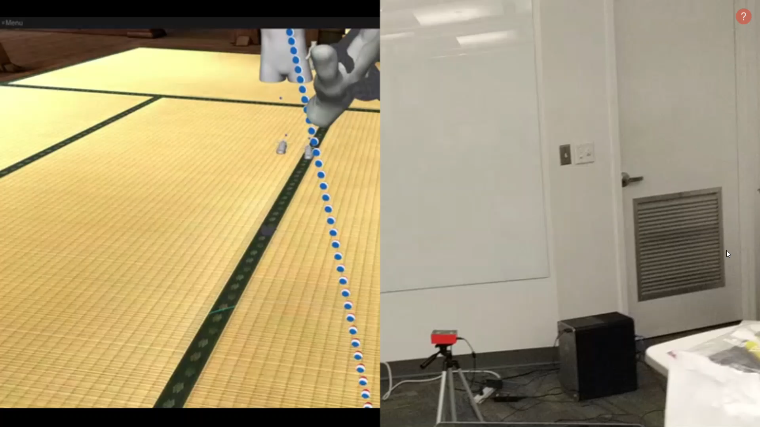

Slide 9
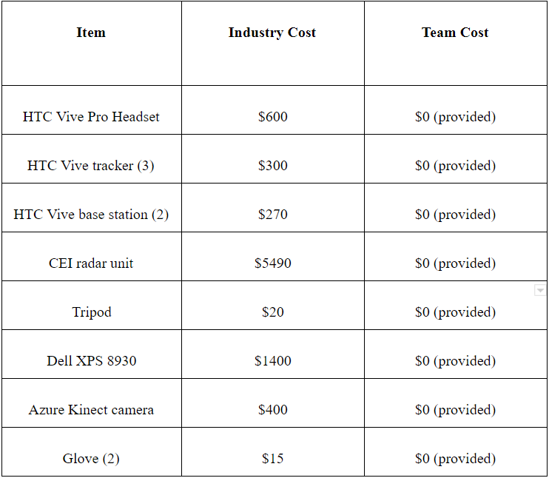
Budget

Slide 10
Conclusion
The prototyped system enables a user to :
Catch a thrown ball while in Virtual Reality
View a live avatar of the ‘thrower’
Observe predicted motion of the ball
Proves feasibility and value of interactions in the virtual realm; opens possibility for future projects to improve lag, response time, and accuracy of the system

Slide 11
Questions ?

